Slide 1


SAP Full-Stack Developer training
ABAP on HANA, UI5 & Fiori, Analytics with OData
Anubhav Oberoy
Day – 16

Slide 2
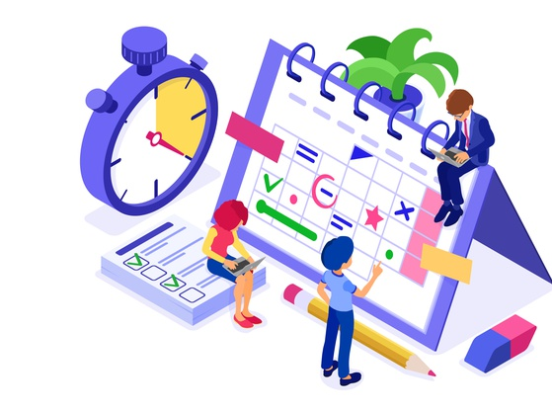
Agenda – Day 16
Hierarchy CDS Programming with Tree Table
New Hierarchy
Classical Hierarchy
Implementation of End to End Hierarchy Scenario of Employee Manager Hierarchy
Describing Functional Information of Hierarchy
Create Fiori App with annotation File on Top of CDS
--Break--
Creating End to End S/4 HANA Scenario for OVP ( Analytics )
Create your OVP ( Overview page ) UX Elements show Analytical dashboard

Slide 3
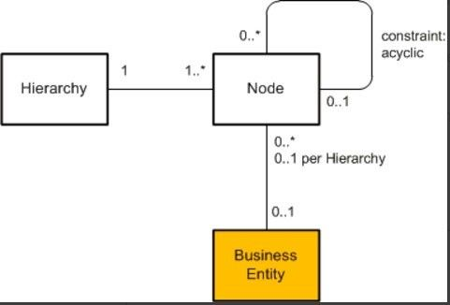
CDS Hierarchy
The CDS view provides a list of hierarchies which is known the hierarchy directory for this node view. Every single node belongs to exactly one hierarchy, which can identified by one or multiple key fields of the node view.
A hierarchy can have multiple root nodes.
Hierarchies allows to traverse data faster
They clearly explain the inter-relation between multiple object
Very helpful determining the parent child relationship

Slide 4
Types of Hierarchy
There are Two types of Hierarchy
Creating Using Annotations
Creating by syntax
CDS Hierarchy
New Hierarchy
Classical Hierarchy

Slide 5
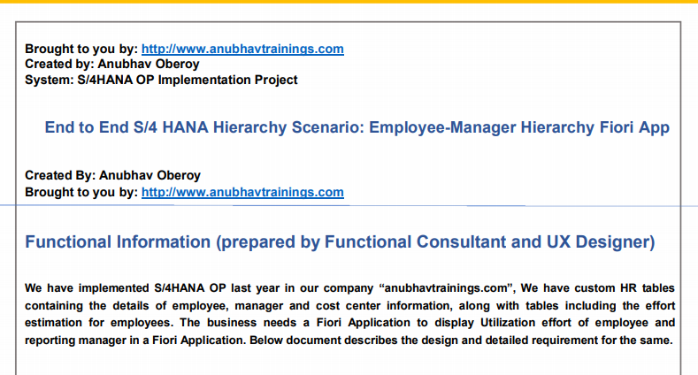
End to End Hierarchy Scenario

Slide 6
Flow of CDS Views in Hierarchy
Consumption CDS View.
Composite CDS View.
Interface CDS View.
Basic CDS View.
ZATS_P_EMPLOYEE
ZATS_I_EMPMGR
ZATS_CO_EMPHOURS
ZATS_C_EMPHOURS

Slide 7
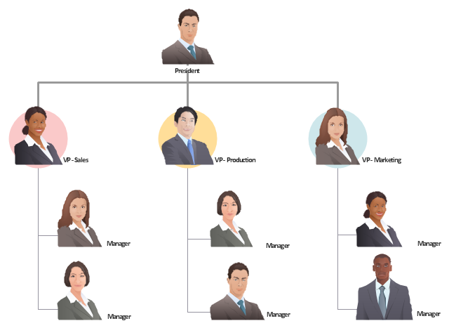
Exercise
CDS Hierarchy Scenario

Slide 8
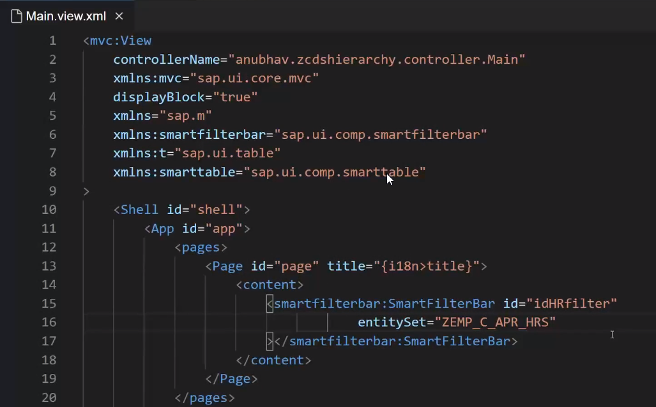
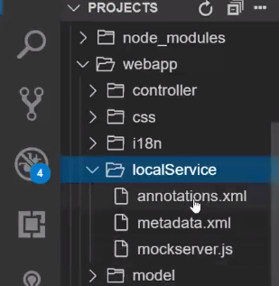
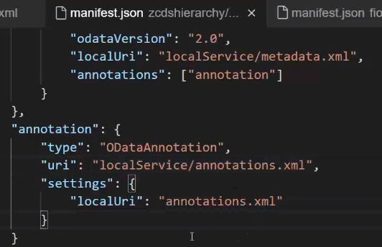
Creating Fiori app on top of CDS
2. Create and add Annotation file in our project.
1. To show All Data in Fiori App we Define or set the Entityset name in XML View.
3. Link annotation file use this code in Manifest.json.

Slide 9
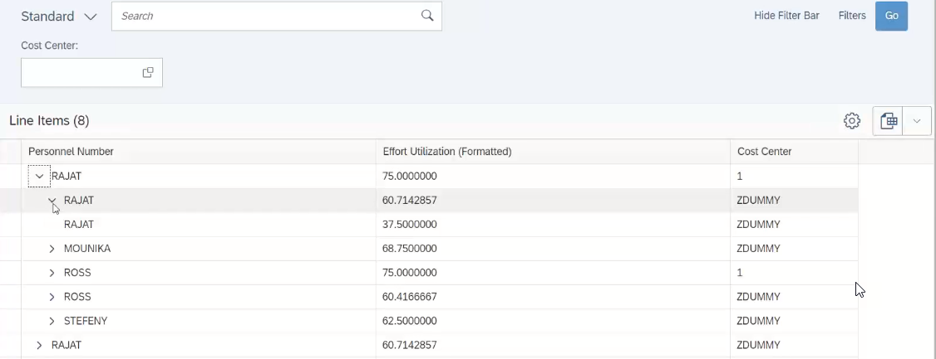
Result Employee Manager Hierarchy
Notes:
The sole purpose of an R/3 system is to provide a suite of tightly integrated, large-scale business applications. R/3 comes prepackaged with the core business applications needed by most large corporations. These applications coexist in one homogenous environment. They are designed from the ground up to run using a single database and one (very large) set of tables.
Presentation: It is usually installed on a user's workstation. When started, the presentation server displays the R/3 menus within a window. This window is commonly known as the SAPGUI, or the user interface (or simply, the interface).
Basis : Basis is like an operating system for R/3. It sits between the ABAP/4 code and the computer's operating system. SAP likes to call it middleware because it sits in the middle, between ABAP/4 and the operating system. ABAP/4 cannot run directly on an operating system. It requires a set of programs (collectively called Basis) to load, interpret, and buffer its input and output. Basis provides the runtime environment for ABAP/4 programs.
Database: The database server is a set of executables that accept database requests from the application server. These requests are passed on to the RDBMS (Relation Database Management System). The RDBMS sends the data back to the database server, which then passes the information back to the application server. The application server in turn passes that information to your ABAP/4 program.

Slide 10

Break

Slide 11
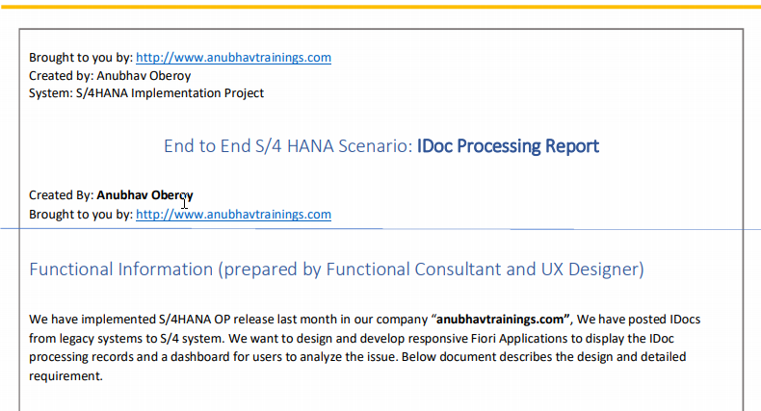
Elaborating End to End S/4 HANA Scenario

Slide 12
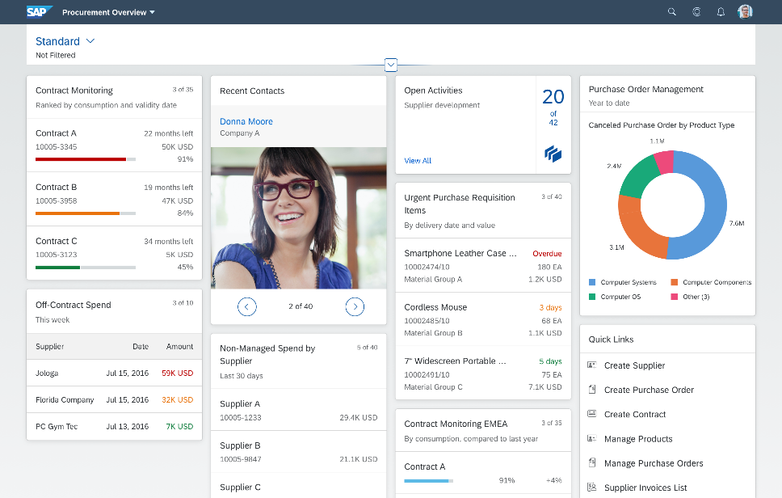
Describing OVP (Overview Page)
Overview pages provide quick access to vital business information at a glance, in the form of visual, actionable cards.
The user-friendly experience makes viewing, filtering, and acting upon data quick and simple. Business users can see the big picture at a glance, and also focus on the most important tasks, enabling faster decision making as well as immediate action.
The displayed data is fully interactive, with clickable areas for easy navigation to relevant applications. Based on SAP Fiori, overview pages organize action items with a fully responsive user interface. Users can access overview pages from SAP Fiori Launchpad and narrow down the information displayed, or opt to hide cards to focus on a particular topic.
The analytical card is a single object card and does not contain a footer area. It can only be used in the overview page (OVP). In the resizable card layout, users can show more content/insights by resizing the card.

Slide 13
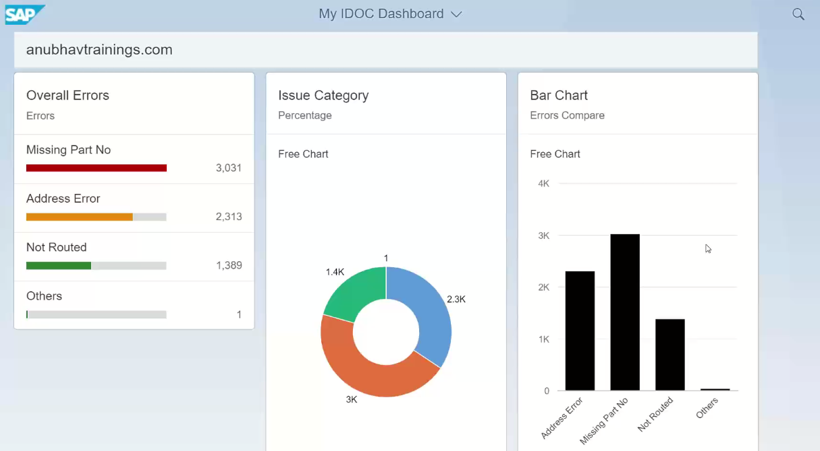
Analytic Dashboard ( OVP )

Slide 14
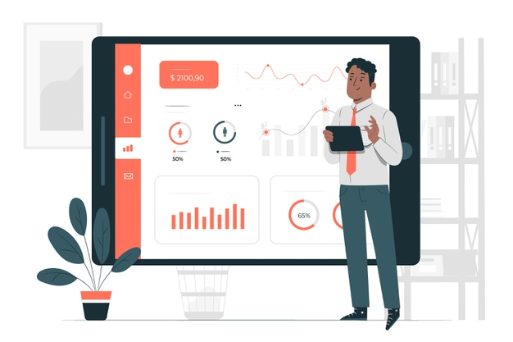
Exercise
End to End S/4 HANA Scenario for Overview Page ( OVP )

Slide 15

End of Day 16

Slide 16

Questions

Slide 17

Anubhav Oberoy

Slide 18


We’re committed to empower you to be
Most Desirable Resource
through powerful training solutions.
We build the workforce of the future.
250+
Corporate Clients
30,000+
Learners Trained
25000+
Learners Placed
FREE WEBINARS
Sign up for free webinars with industry experts every fortnight!
Enroll Now!
Contact us today!
https://anubhavtrainings.com/

Slide 19




More from AnubhavTrainings.com

